Slide 1
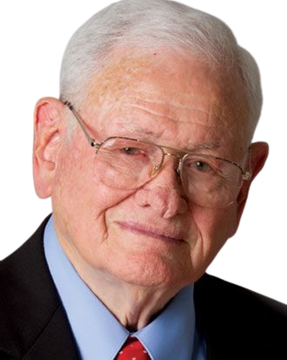
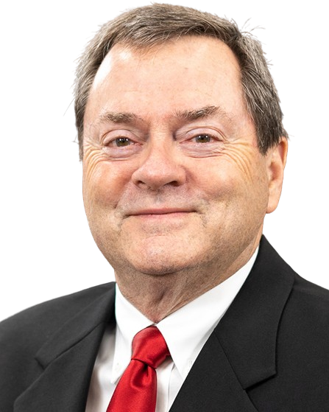
Founded 1948 in Henderson, Texas
Sponsoring Church: Calvary Baptist Church – Henderson, TX
Mission Statement:
Texas Baptist Institute & Seminary equips saints to do the work of ministry through Biblically-based higher education in harmony with the Bible doctrines of the American Baptist Association to advance the Kingdom of God through the local church ministry of fulfilling the Great Commission.
Offers 175 courses with 5:1 student to faculty ratio
Enrollment: 116 undergraduate & 28 graduate students
Divisions: Institute (associate & baccalaureate), Seminary (master & doctoral), & Bible Initiative
Accredited by the Associate for Biblical Higher Education
Opportunities include funding & construction for campus renovations, pantry stocking, & TBI Allies scholarship drive
President Emeritus
Ray O. Brooks
President/CEO
Steve Butler
info@tbi.edu
txbaptist
903.657.6543
txbaptist
@txbaptist/streams
www.tbi.edu

